Slide 1




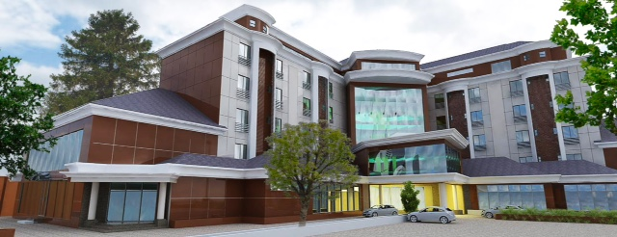
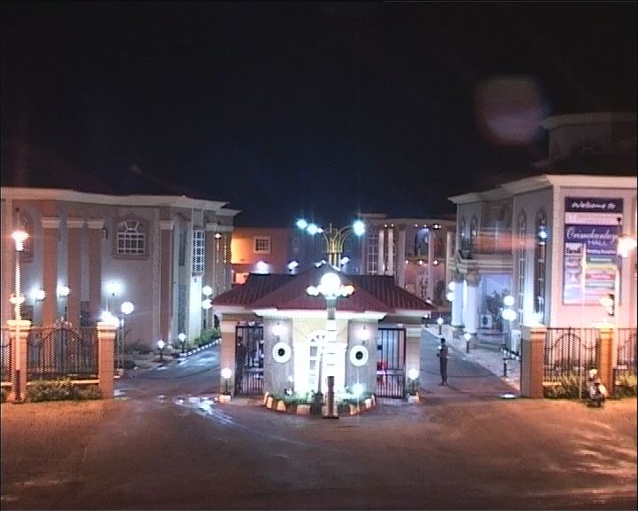
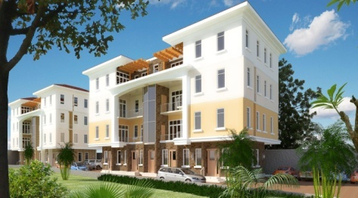
LEGO CONSULT LTD
CIVIL ENGINEERS, ARCHITECTS, BUILDERS
&
PROJECT MANAGEMENT
(SINCE 1997)
COMPANY PROFILE
Head Office:13, John Olugbo off Toyin Street Ikeja, Lagos.
Tel:08026804720, Mobile:08037193411
admin@legoconsult.com,legoconsult13@gmail.com
www.legoconsult.com

Slide 2
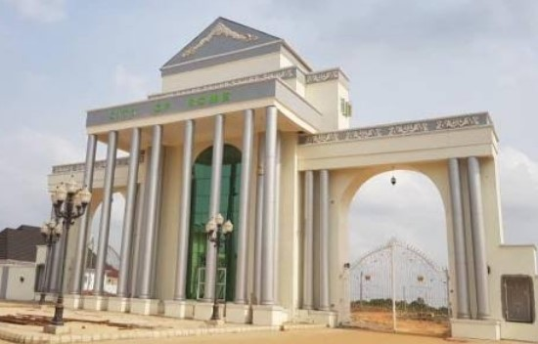
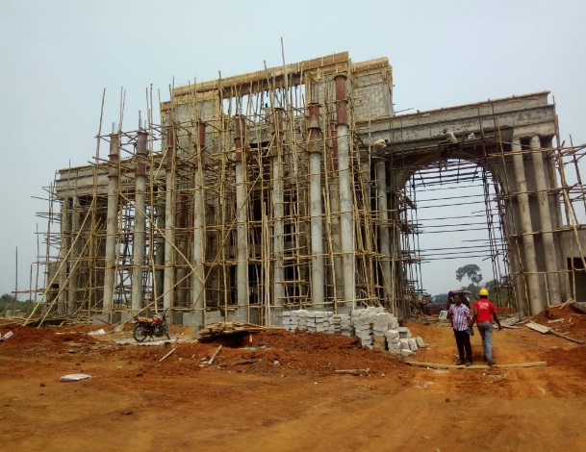
TABLE OF CONTENT
ABOUT US
2. GENERAL STATEMENT
3. OUR SERVICE
4. OUR TEAM
5. MANAGEMENT PROFILE
6. REGISTERATION CERTIFICATE
7. REFERENCE PROJECT/PICTURES
8. LIST OF EQUIPMENT & MACHINERY
AFTER
BEFORE

Slide 3
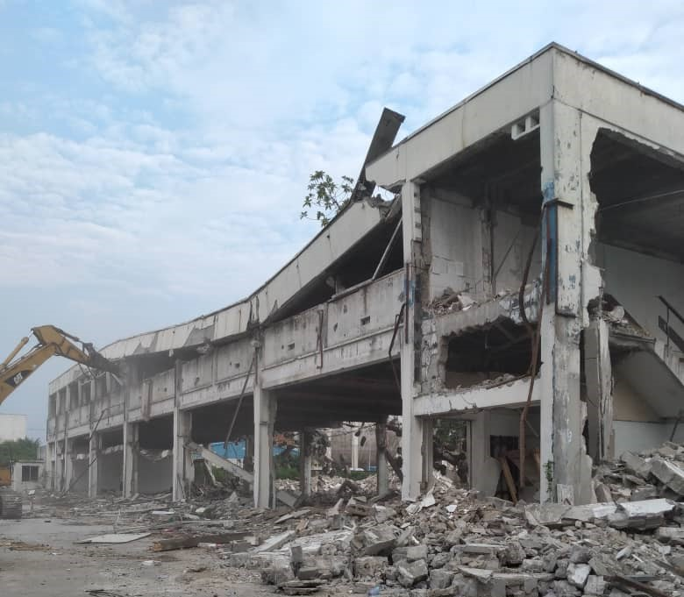
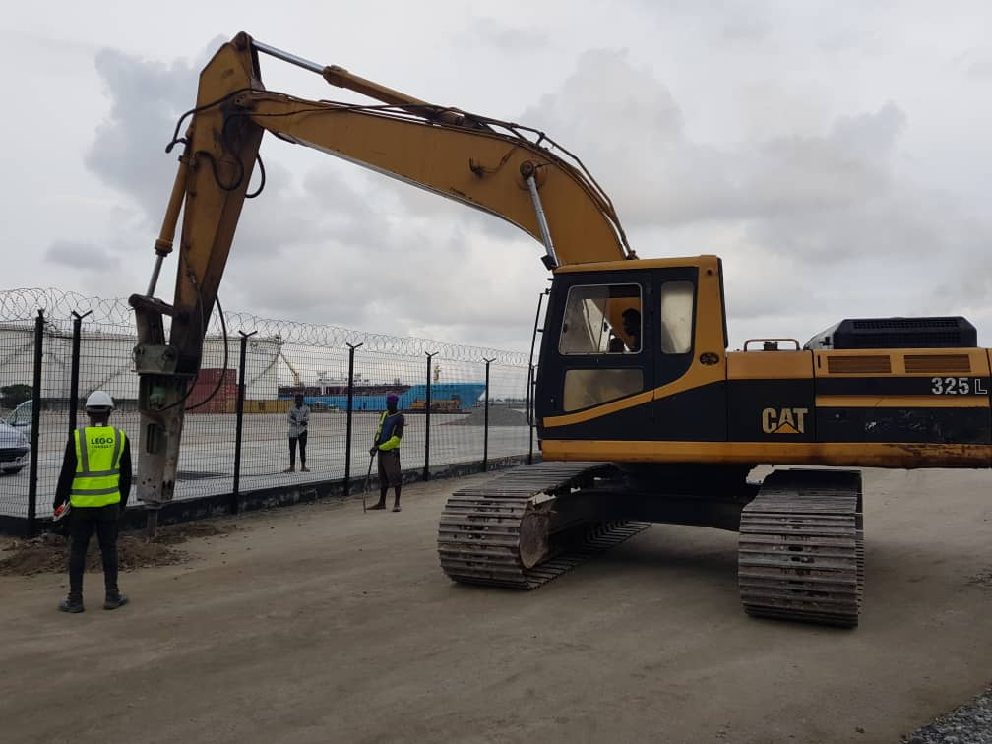
ABOUT US
Incorporated in December 1997 as a business enterprise in Architectural design and later metamorphosed to a limited liability company in Architecture, Building Construction, Real Estate and Interior Design; We are a firm of multi-disciplinary professionals with expertise in different phases of project development and implementation. LEGO CONSULT has been responding to an increasingly complex environment in the design and construction market.
JOHN HOLT DEMOLITION, APAPA
GMT BONDED TERMINAL

Slide 4
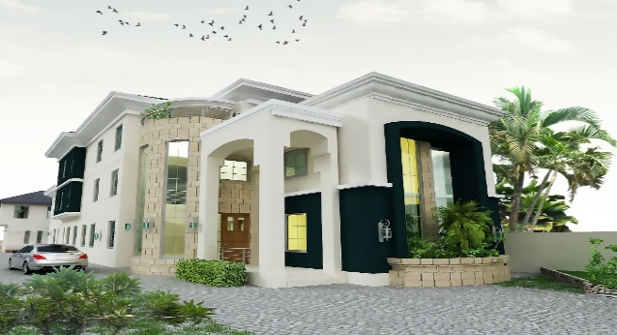
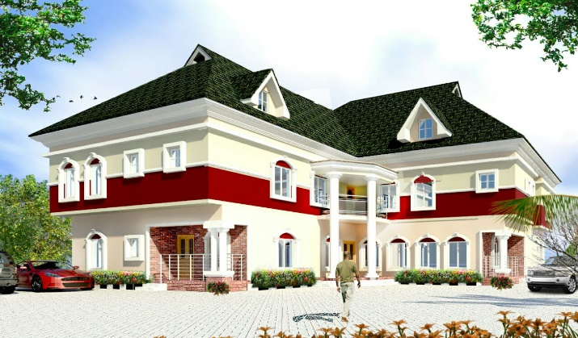
MISSION
To offer and deliver functional and creative architectural designs with cost effectiveness and obsolescence in mind.
Project Management services using challenges to seek
opportunities as industry thinker who quickly respond to client's needs.
VISION
LEGO CONSULT LIMITED envisions to be in the nearest future, an acutely distinct architectural
and construction outfit renowned in the industry
for it’s responsive, innovative and quality
service delivery at optimum time, cost
and quality.

Slide 5
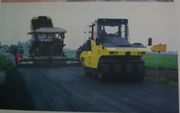
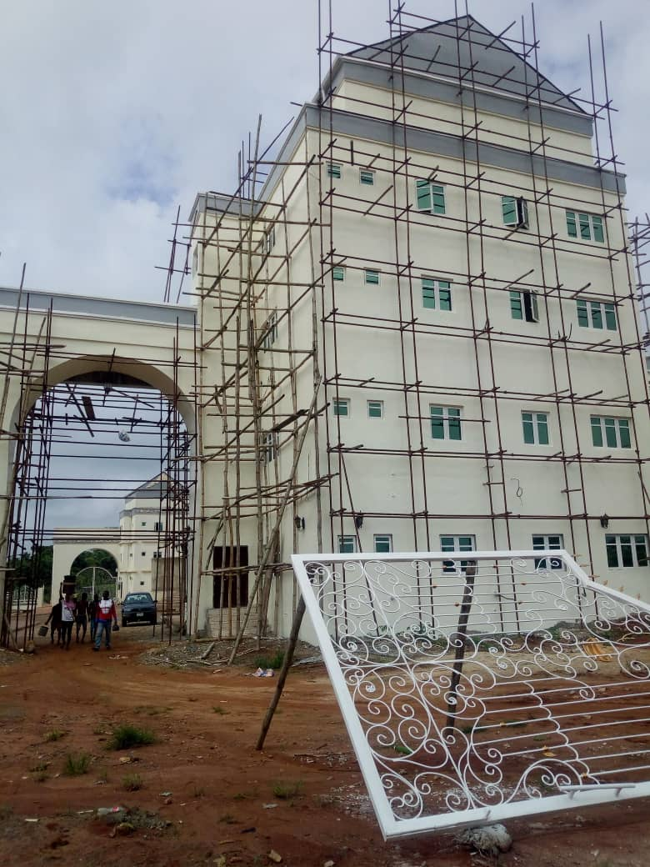
OUR SERVICE
LEGO CONSULT offers comprehensive
design and planning services to meet the
divergent needs of clients in Lagos, Abuja, Ekiti,
Imo and beyond.
We are a firm of multi-disciplinary professionals with expertise in different phases of project development and implementation.
LEGO CONSULT places strong emphasis on creative design details, practicality as well as cost optimization of every solution.
Our mission is to sustain our growth, hence we
strive to retain our focus: “Prompt attention
to clients!” therefore our organization is
structured to be sensitive and responsive to the
concern of the client. This is why every job
captain is trained to be passionately
devoted to his project.
ROAD CONSTRUCTION
BUILDING CONSTRUCTION

Slide 6
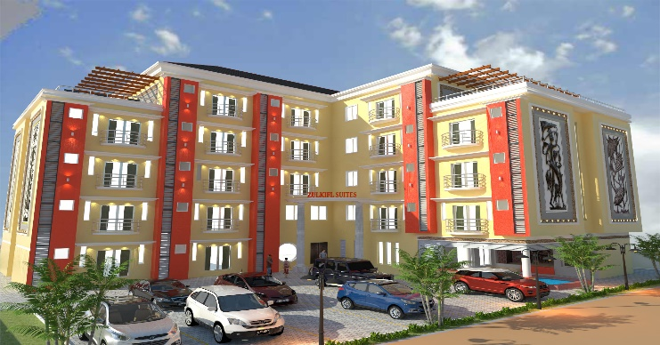
CIVIL/ STRUCTURE WORKS
Our output to the construction
industry includes the installation
of several civil works:
• Reinforced Concrete Structures
• Underground Fuel Dumps
• Road Construction work
• Petrol Station
• Earth works/Retaining walls
•Soil Investigation
•Waterproofing
RESIDENTIAL BUILDING
Your home: A sample country-side bungalow, a sprawling sub-urban haven, a luxury apartment or even an urban condominium, trust LEGO CONSULT to conceptualize your brief and adapt appropriate construction technology to make your dream a reality.
CONSTRUCTION
Building Construction
Swimming Pool
Civil works
Steel works

Slide 7
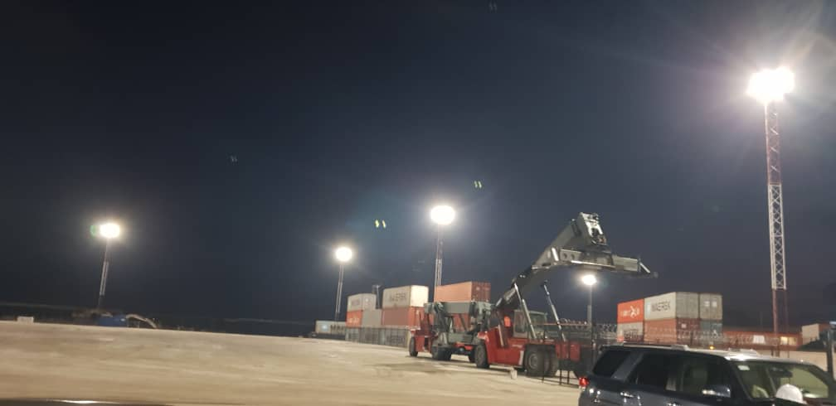
Our Team
Taofiq Jide Simisaye Adebimpe Saibu Ajibade
MD/CEO Technical Director
BSc/MSc.Arch Civil Engineer COREN
Abdullateef Ademoye Olatunji Yinka
Executive Director Quantity Surveyor
Architect MNIA NIOB
Ajuogu Kate (Mrs) Ayobami Oke
Head of Admin Head of Operations
Taoheed Alabi Bolaji Agidigbi(Ms)
Project Coordinator Civil Engineer
Ismail Nurudeen Abari Rasaq
Architect Estate Surveyor
Damilola Yahaya Omole Sarah
Quality Control Accountant
Bonded Terminal Electrification, GMT Shipping, Apapa

Slide 8
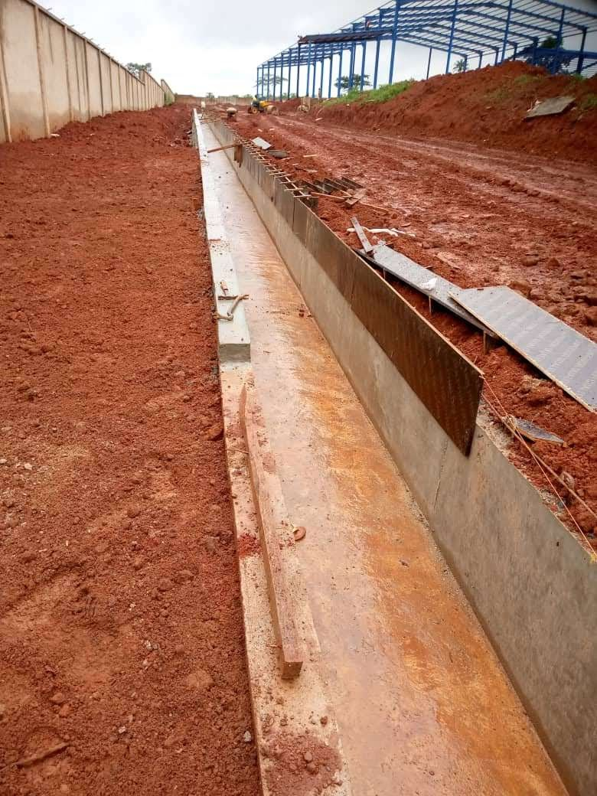
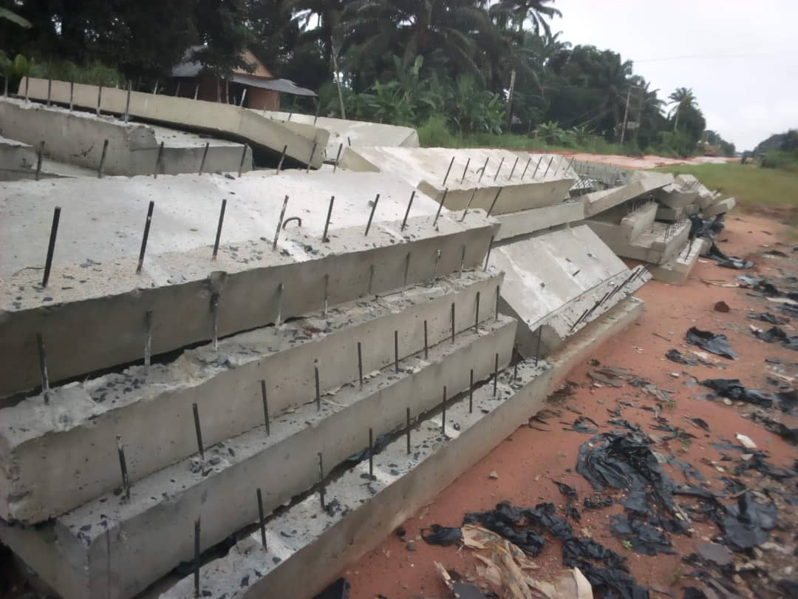
MANAGEMENT PROFILE
Drainage Construction
Drainage Construction

Slide 9
Name: TAOFIQ JIDE SIMISAYE
Position: MD/CEO
He is one of the pioneers of the company and the Chief Executive Officer of Lego Consult. He is a consummate, fascinating, inspirational, innovative, amiable and resilient Architect with over 20 years experience in building construction, project Management, infrastructure development, real estate, interior design and managerial experience. He started his educational career with an OND/HND in Architecture at the prestigious Yaba College of Technology and later proceeded to obtain a Bsc. and Msc. in same field at the University. Taofiq Jide Simisaye also has a PGD in Project Management from Federal University of Technology, Owerri (FUTO).
Taofiq JIde Simisaye successfully co-ordinated the projects below from inception to completion as Project Manager or Head of Construction Team;
Pathfinder Hotel, Ado-Ekiti; Falana & Falana Chambers Office Complex, Abuja & Lagos; Education Trust Fund Renovation of Secondary School in Ekiti State; Upright Hotels, Abeokuta; Prestige Paints Factory, Landscaping of National University Commission, Abuja; Prime Estate, Phase I & II, Ofada; Treasure Palace Hotel, Lagos; Yemkem Pharmaceutical Factory, Igbesa, Ogun State; Peve Dental Clinic, Agege, Lagos. He was also the Project Manager at the renovation of Lagos Chambers of Commerce & Industries Office in V.I, Lagos and presently one of the Project Managers for the ongoing Lagos Bus Terminal Project and many other projects.

Slide 10
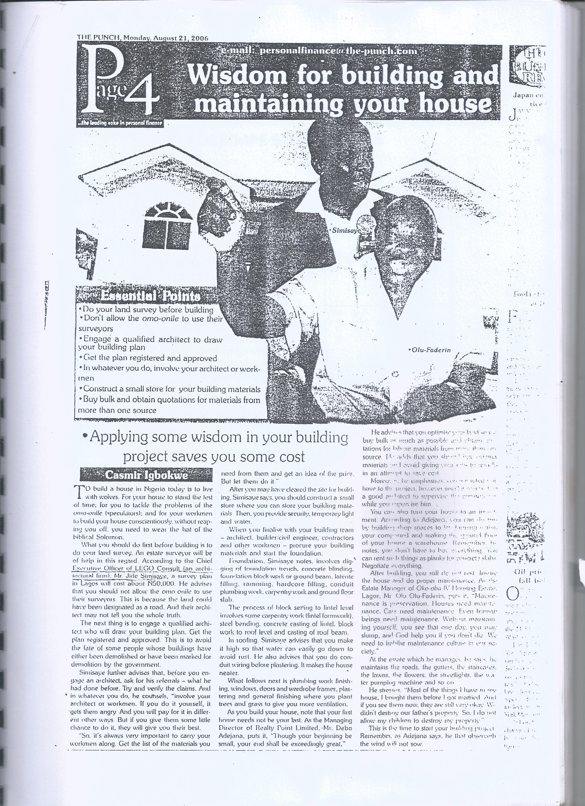
Attached to this are few newspaper articles to his credit;

Slide 11
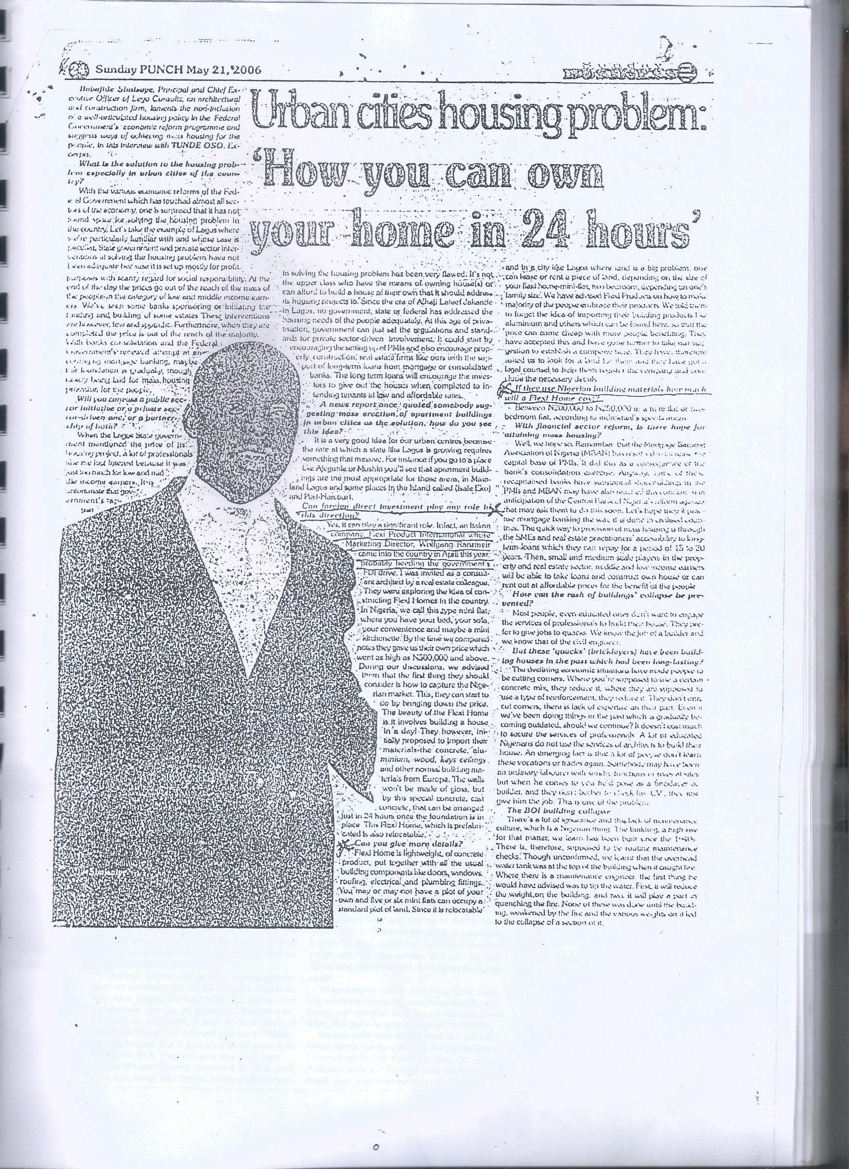

Slide 12
Name: ENGR. ADEBIMPE SAIBU AJIBADE
Position: Technical Director
Engr. Adebimpe Saibu Ajibade is also one of the pioneers of Lego Consult and presently the head of the Technical team. He studied at the University of Ibadan where he graduated in 1987. He was a member of Surveyors’ team with Tunji Folabi & Co. (License Surveyor) Mokola Ibadan involved in the sitting-up of control marks (Subsequent Survey) along Lagos and Ogun boundary (Isheri-Iju axis) for the Federal Survey Department.
In 1988 he became the Site Engineer with Pot Engineering Development Company, Bodija Ibadan. During the construction of Iwo-Oshogbo Road project and bridge over “Awun” river at Ede. Supervised earth moving, curvetting, layering of sub-base, base course priming and asphalting works.
He was the Engineer with Hydra Consultant/ Lamod Engineering Services in the construction of UCH Mosque, Minaret and construction of its foundation.
He was also a Project Engineer with Labaran Kago & Sons where he took part in the construction of Prototype Gum-parks units for the Nigerian Army corps of artillery and school of NACAS, Minna, Niger State.
He joined Lego Consult in the late 90s where he also took part in most of their projects as Head of the Engineering team.

Slide 13
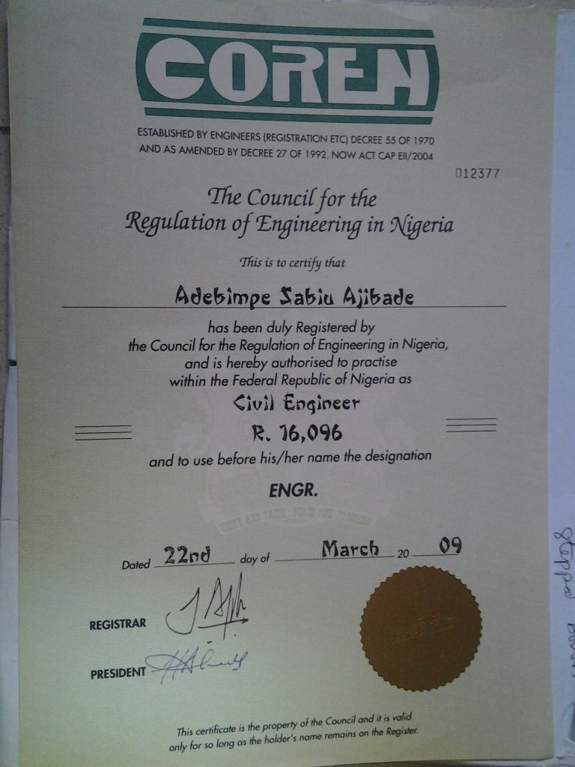

Slide 14
Name: YINKA OLATUNJI
Position: Project Director
QS Yinka Olatunji joined Lego Consult in 2008 as the Head Quantity Surveyor. He started as a Quantity Surveyor in National Bank of Nigeria in 1988 and later joined Techno-land Construction Ltd as Contract Manager. He moved on to
Construction & Design Co. Lagos as their Senior Quantity Surveyor until 2004.
He participated in the renovation of Deverserve Tower 104/106 Apapa road, Lagos. He was also part of the Consulting team during the construction of National Bank Agodi Branch Ibadan, Oyo State. He also participated in the
Construction of Cement factory at Onigbedu, Ogun State.
Other Projects he participated in as the Head Quantity Surveyor are; Construction of Standard Plaza, at plot 1428, Aminu Kano Crescent, Wuse II, Abuja, Rehabilitation of Participant Hostel at ASCON Badagry Lagos, Construction of National Industrial Court Complex, Kano, Construction of Block of Classrooms at Ndanaku, Rogun and Gbabe in Kwara State, Construction of National Industrial Court, Kaduna Temporary Court and the Construction of twins duplex in Badagry Lagos and many other projects.
He is a member of Nigerian Institute of Building (NIOB) and Nigerian Institute of Quantity Surveyors (NIQS).

Slide 15
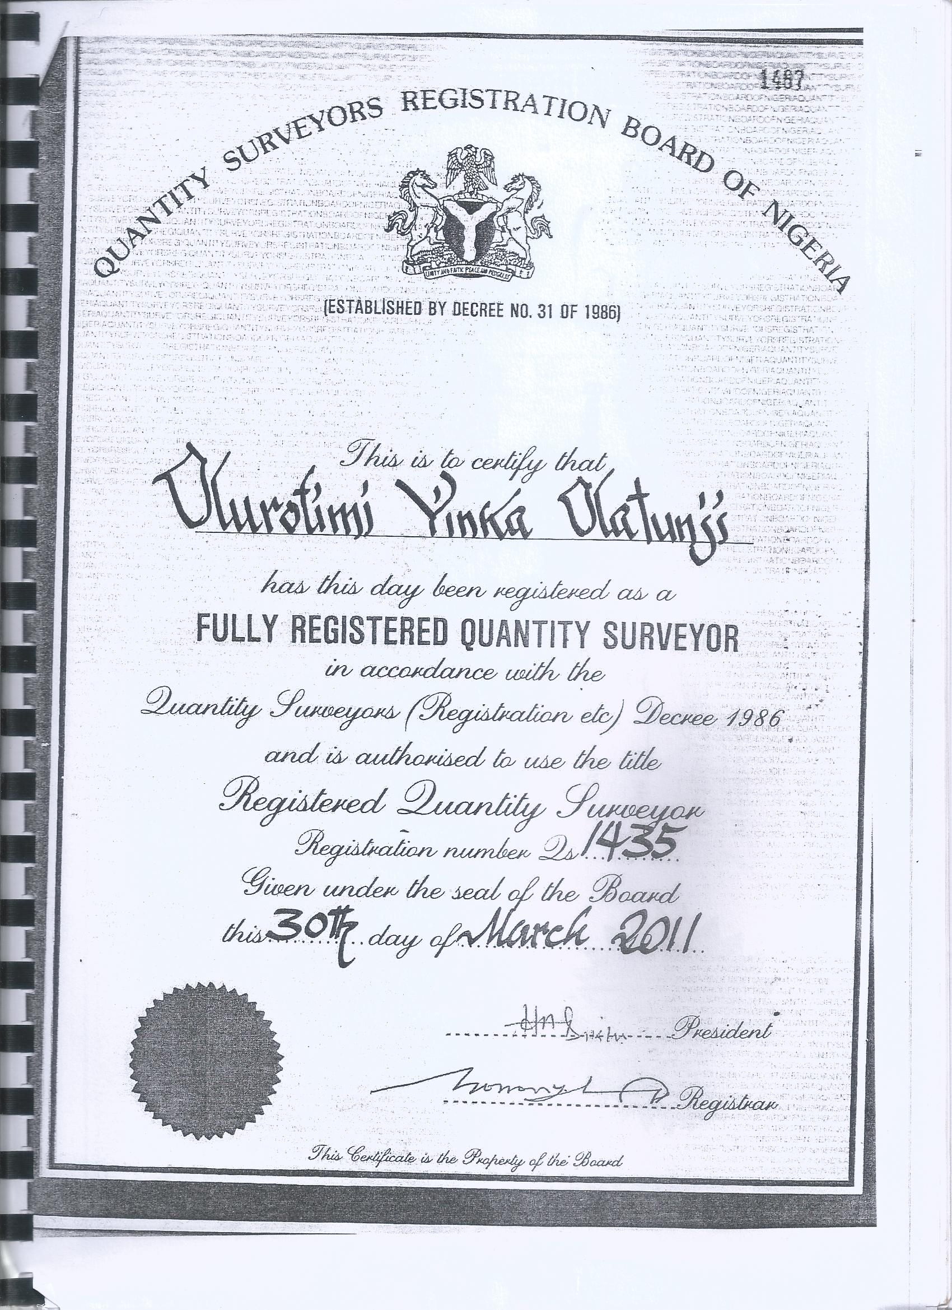


Slide 16
Name: ADEMOYE ABDULLATEEF OLUMUYIWA
Position: Executive Director
He is an accomplished, exceptional and integrity-driven pro-active professional Architect, he started his career at Ogun State Polytechnic in 1991 where he obtained his OND Architecture. In 1993 he went on to the University of Jos to bag B. Sc. Architecture. He proceeded at the same University of Jos in 1999 to obtain his M. Sc. Architecture. In 2004 he went to the prestigious University Of Lagos, Akoka, where he obtained Advance Certificate in Project Management.
He was one of the Project Management team during the construction of Southern Sun Hotel along Alfred Rewane Road, Ikoyi, Lagos.
Arc. Ademoye is a Manager with substantial experience and proven ability to provide high level of architectural Consultancy services and Project Management Services. His core competence are in the area of iconic Architectural Design, Project Management, Cost and Quality Control. He is also very experienced in Construction, Contract and Conducting Technical / Site Meetings.
He is a member of America Institute of Architects (AIA), Nigeria Institute of Architects (NIA), Architects registration council of Nigeria (ARCON), Nigeria Institute of management (NIM) and Project Management Institute (PMI).

Slide 17
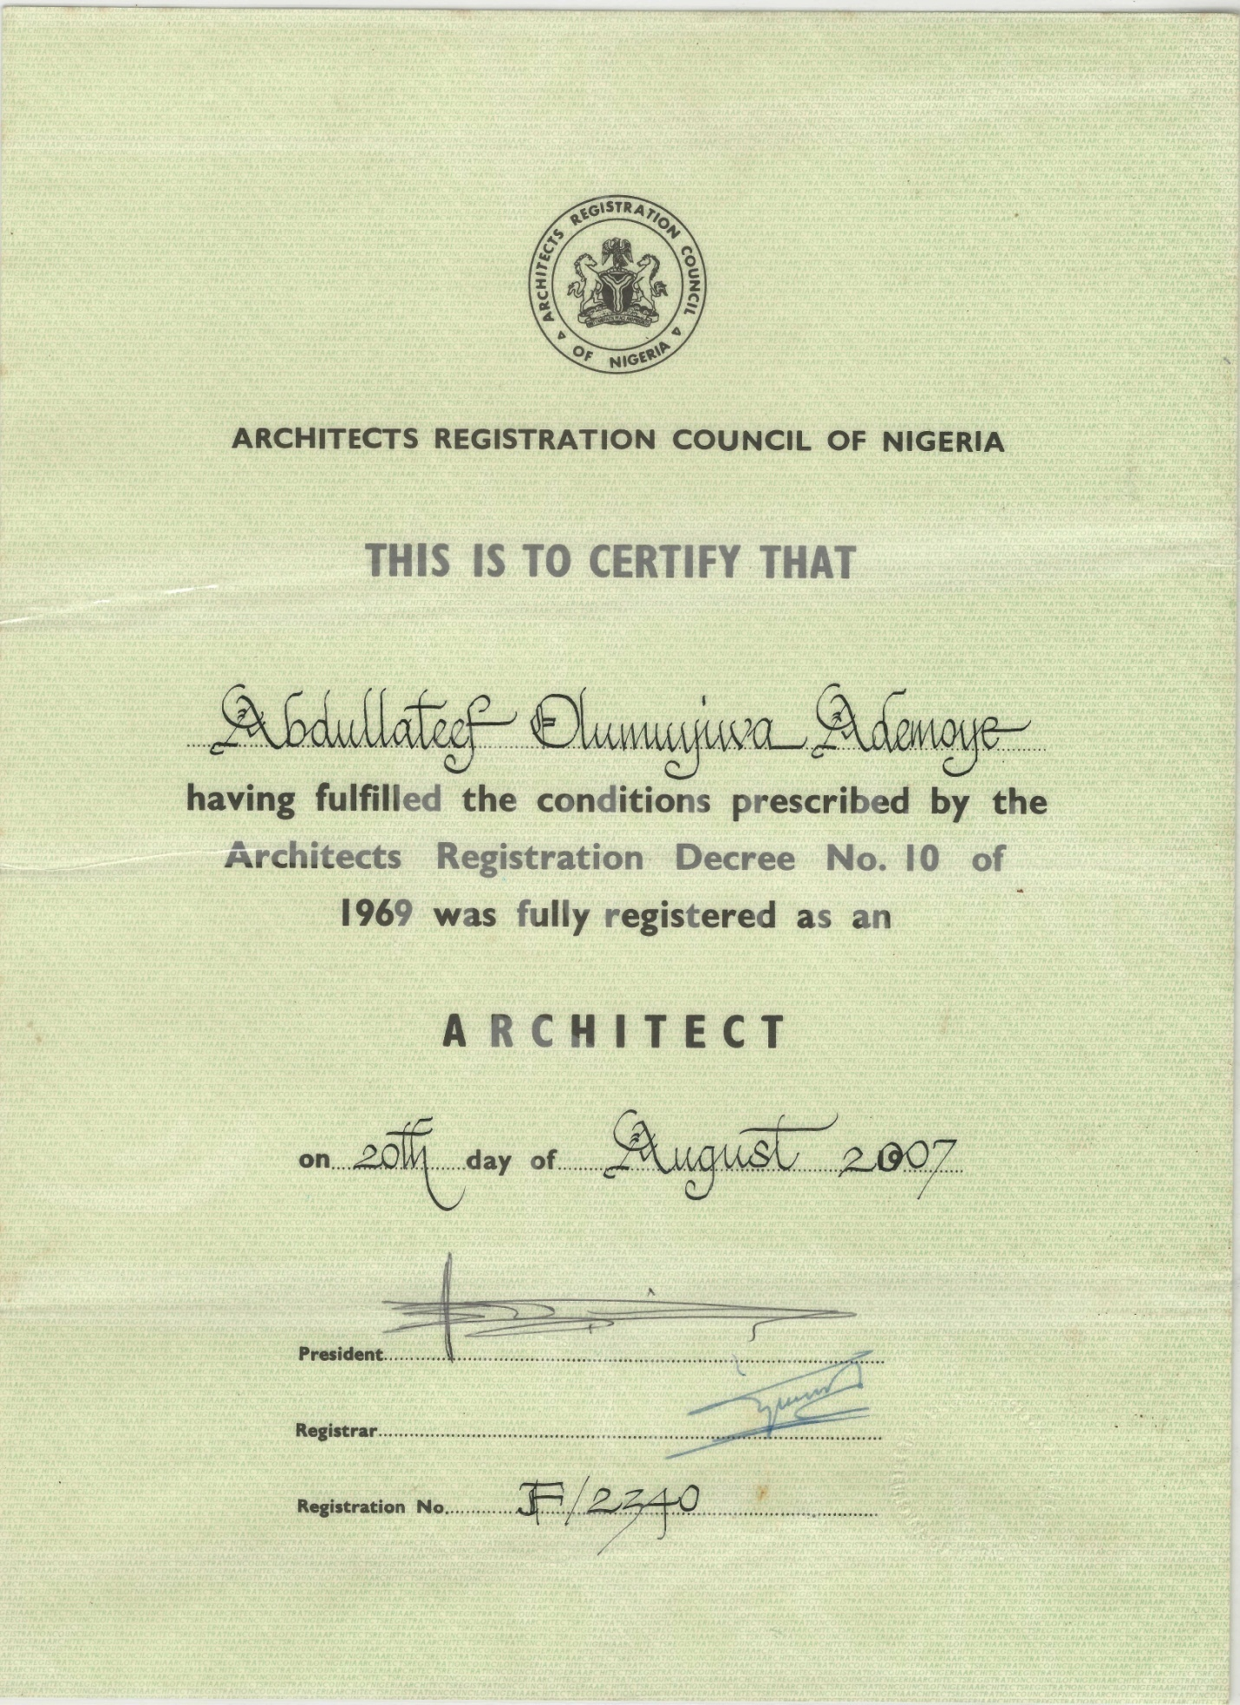

Slide 18
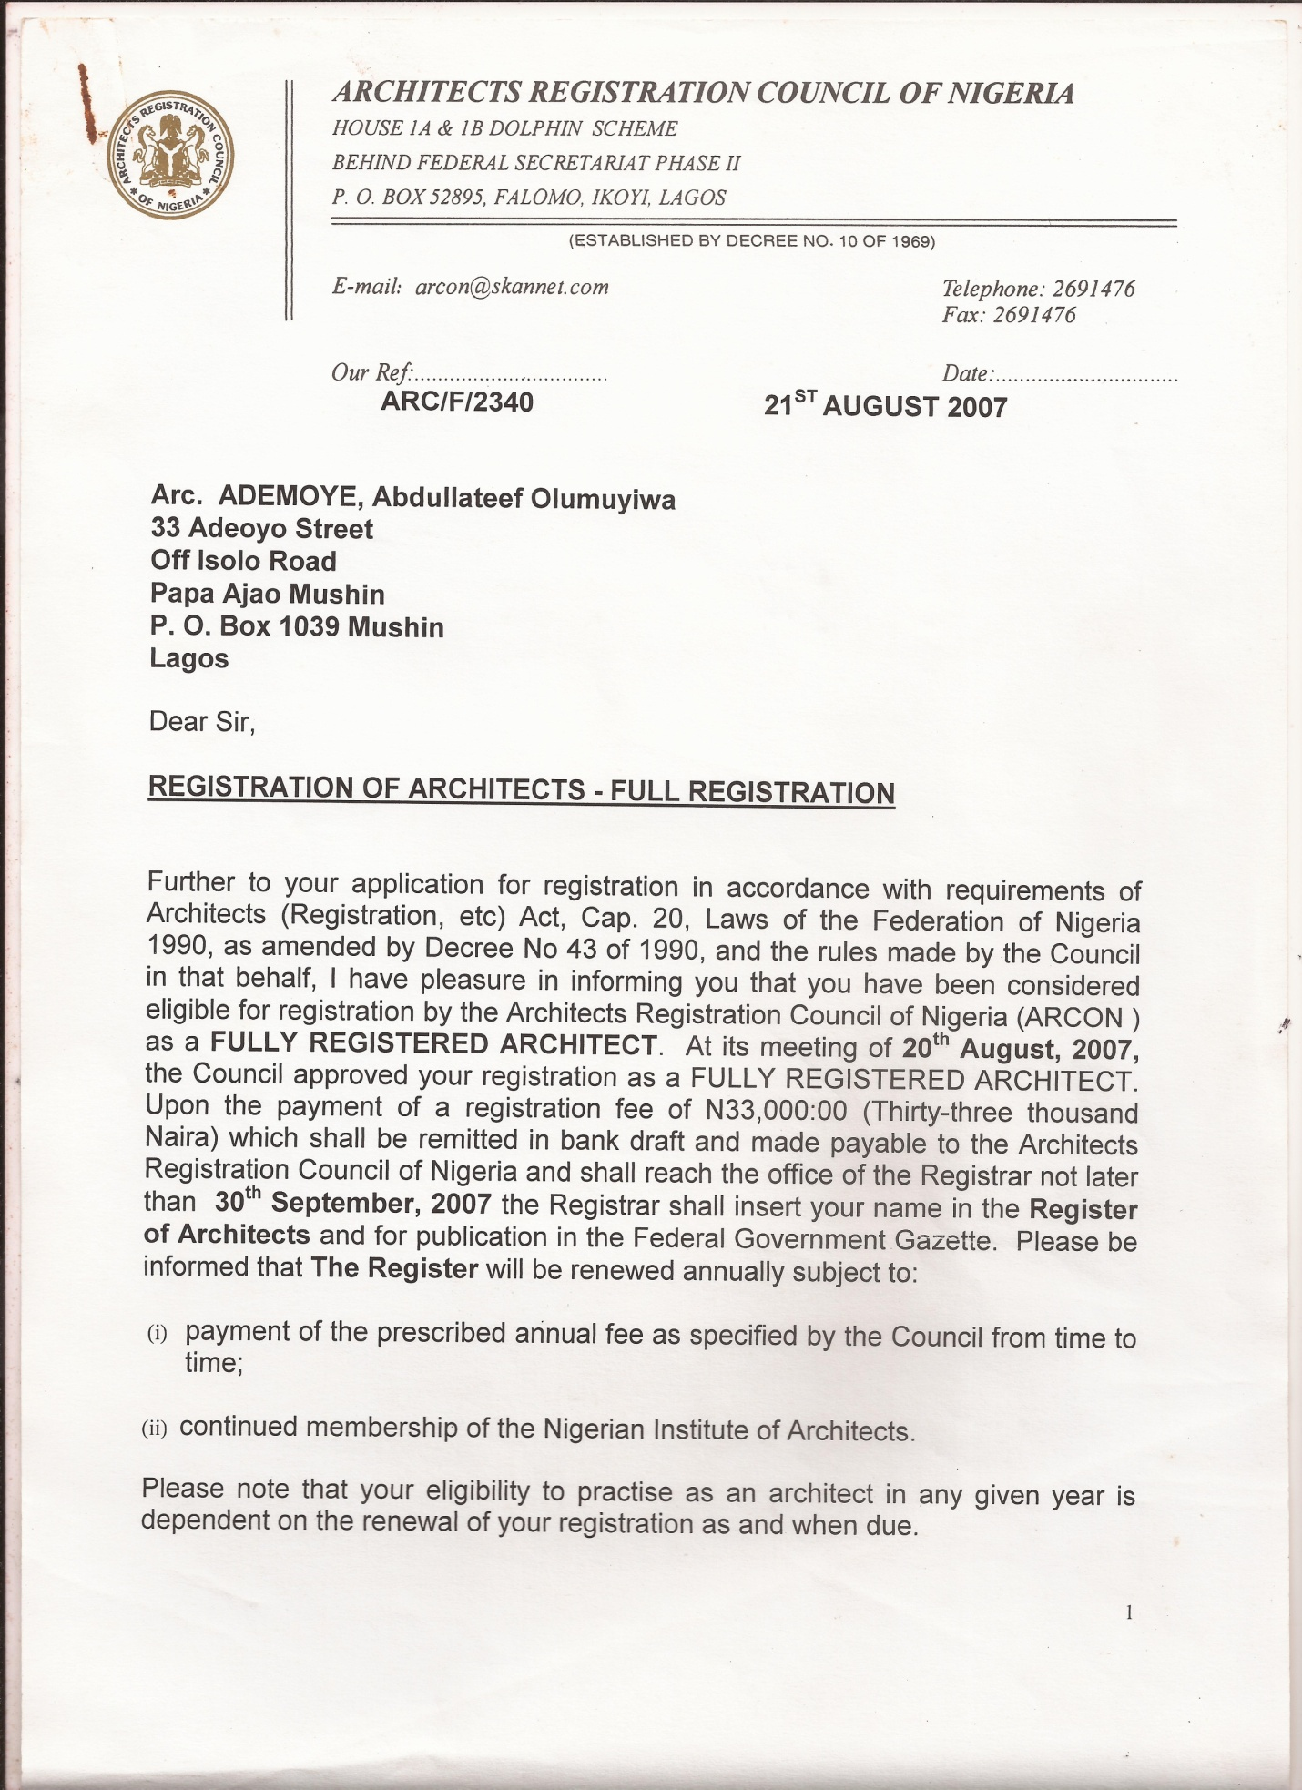

Slide 19
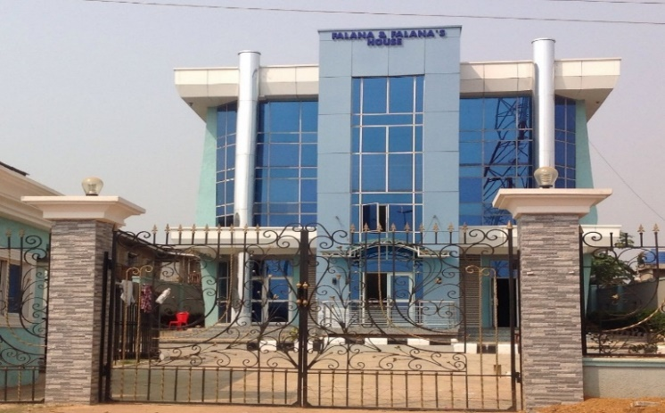
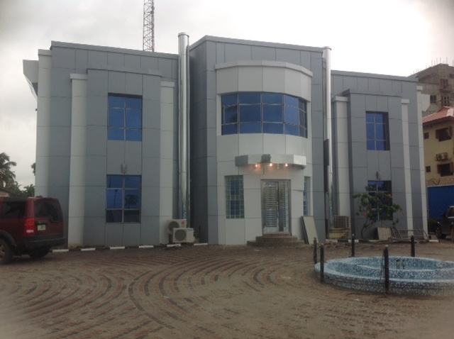
CLIENTS LIST
&
JOBS EXECUTED

Slide 20
SOME OF OUR CLIENTS
1. GMT SHIPPING NIG. LTD 6. BERGER PAINTS LTD
2. REALTY POINT LTD 7. PRESTIGE PAINTS LTD
3. YEMKEM INT’L NIG LTD 8. LAGOS STATE GOVERNMENT
4. FALANA & FALANA CHAMBERS 9. EKITI STATE MINISTRY OF EDUCATION
5. UNIVERSAL BASIC EDUCATION COMMISSION 10. LAGOS CHAMBER OF COMMERCE & IND.
SOME OF OUR PROJECTS
Project: JUNIOR GIRLS MODEL SECONDARY SCHOOL
Location: Ilawe, Ekiti
Client: Universal Basic Education Commission
Cost: ₦249,805,150
Duration:18 months – 2016/2018
Job description: Construction of 2 blocks of Hostels, Classroom, Dining and Staff Quarters.
Project: PRESTIGE PAINT FACTORY.
Location: Atan Ota
Client: Dr. Olabayo Oyadiran.
Cost: ₦72,000,000
Duration:6 months - 2019
Job description: Renovation of paint production factory and storage warehouse, internal factory premises road construction.
Project: LAGOS BUS TERMINAL
Location: Agege, Ojota & NAHCO.
Client: Lagos State Government
Consultant: PMO Africa
Date: April 2018/2019
Duration: 9 month (Ongoing)
Job Description: Project Management, & Supervision
Project: BONDED TERMINAL PROJECTS
Location: Apapa, Lagos
Client: GMT SHIPPING NIGERIA LTD
Duration: 3 months - 2019
Job description: Architectural Design/Supervision
& Construction of Custom offices, Terminal Electrification & concrete flooring.
Project: 8 UNIT LUXURY FLATS
Location: Ogunkelu Street, Arowojobe, Estate.
Client: Mr. Wasiu Oladimeji Lawal
Cost: 65,000,000
Duration: 24 months - 2018
Job Description: Architectural design, supervision, consultancy & construction of 8 Units luxury flats.
Project: OFFICE RENOVATION
Location: 1, Idowu Taylor, Victoria Island, Lagos
Client: Lagos Chamber of Commerce and Industry
Cost: ₦18,900,000
Duration: 8 weeks - 2015
Job description: Architectural Design, consultancy, Supervision & renovation.
Project: LUXURY DUPLEX
Location: Omole phase II
Client: Alhaji Hazeez Mumeen
Cost: ₦55,000,000
Duration: 11 months - 2017
Job description: Architectural design, supervision, consultancy & construction of Luxury detached duplex with interior finishing.
Project: COMMERCIAL BANK BRANCH
Location: Abbatoir Complex, old Abeokuta road, Oko- Oba.
Consultant: Leobiga Associates
Client: Eco Bank Plc
Cost: ₦12,684,000
Duration: 12 weeks - 2010
Job Description: Renovation of commercial bank with interior & external finishing.
Project: YEMKEM FACTORY.
Location: Igbesa
Client: Yemkem Int’l ltd.
Cost: ₦674,650,100
Duration:24 months - 2016
Job description: Architectural Design/Supervision
&Construction of factory consisting of production building, cafeteria, boiling section & fermentation block.
Project: OFFICE COMPLEX
Location: G.R.A ikeja Lagos.
Client: Falana & Falana Chambers
Cost: ₦48,000,000
Duration: 9 month - 2012
Job description: Architectural Design & Construction of
a modern state of the heart law firm.

Slide 21
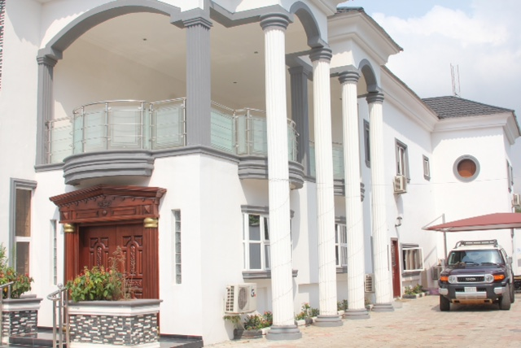
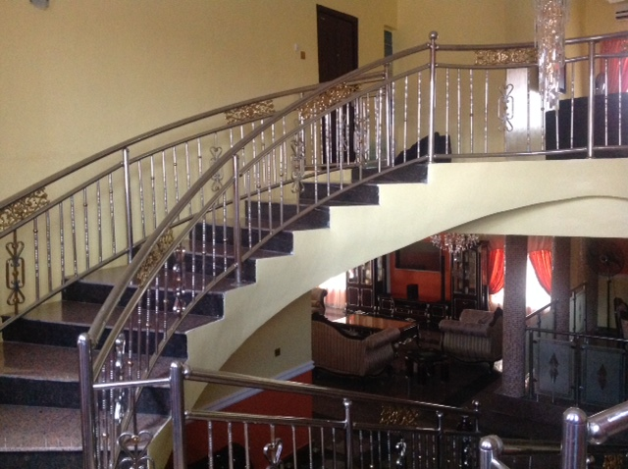
REGISTRATION
CERTIFICATES

Slide 22
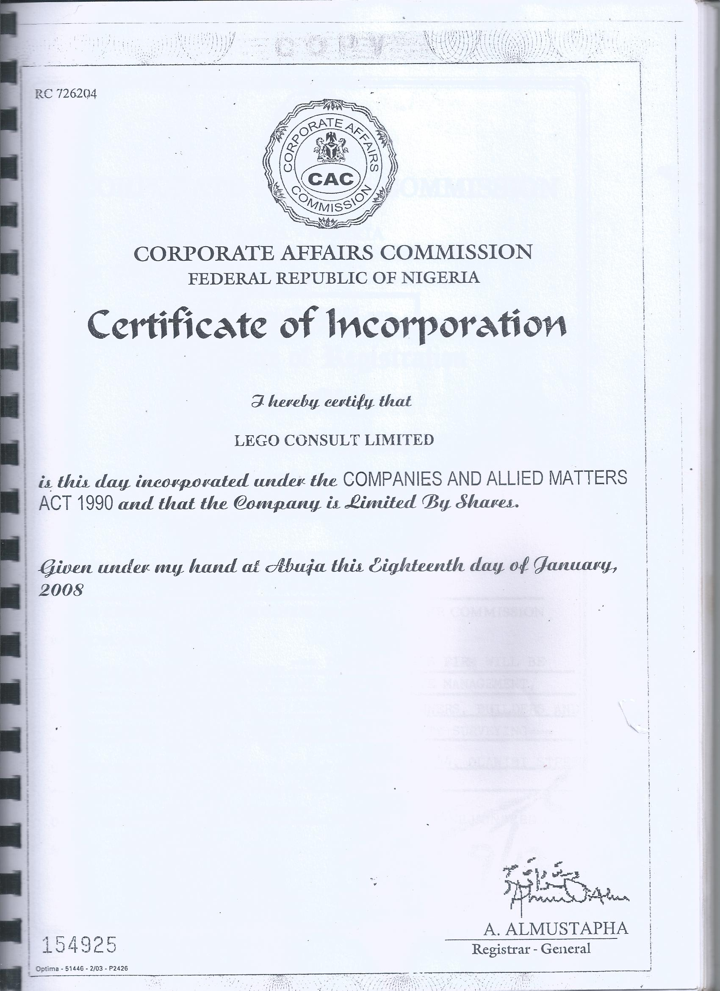

Slide 23
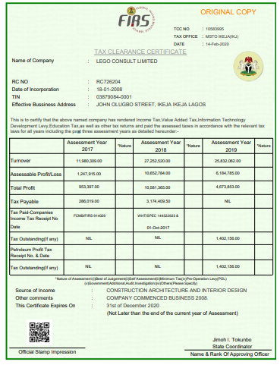

Slide 24
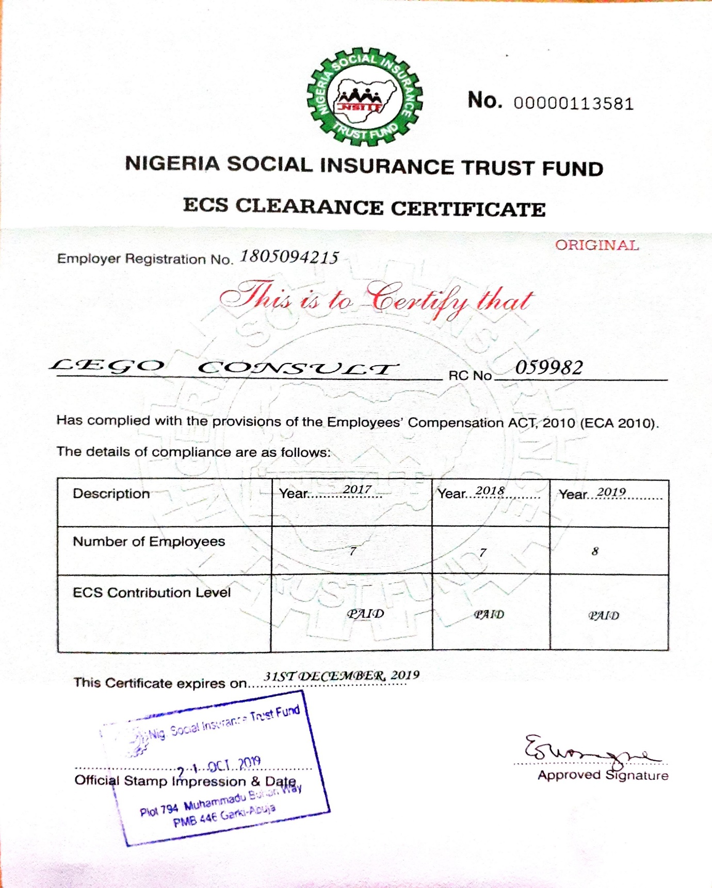

Slide 25
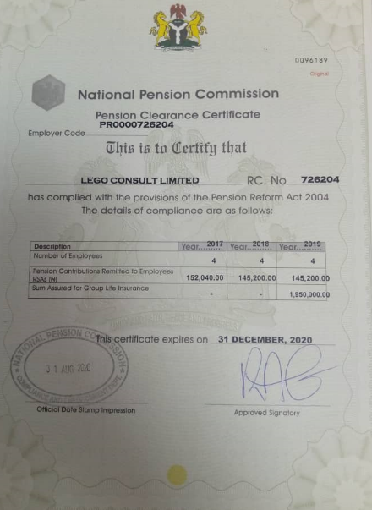

Slide 26
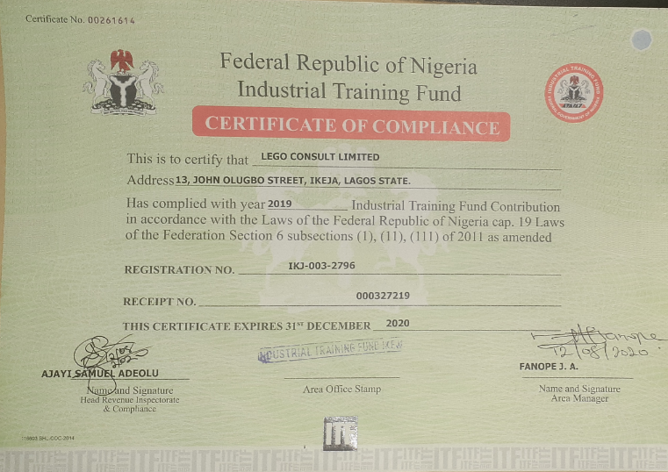

Slide 27
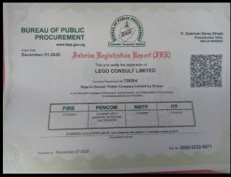

Slide 28
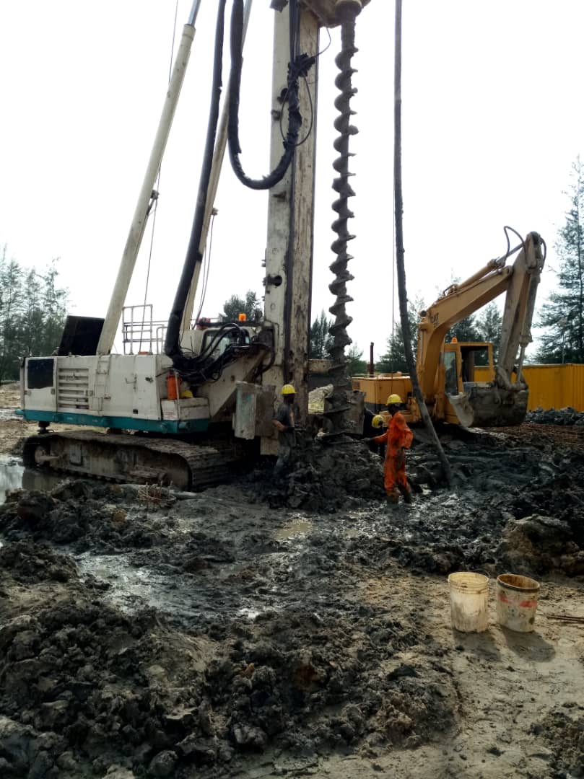
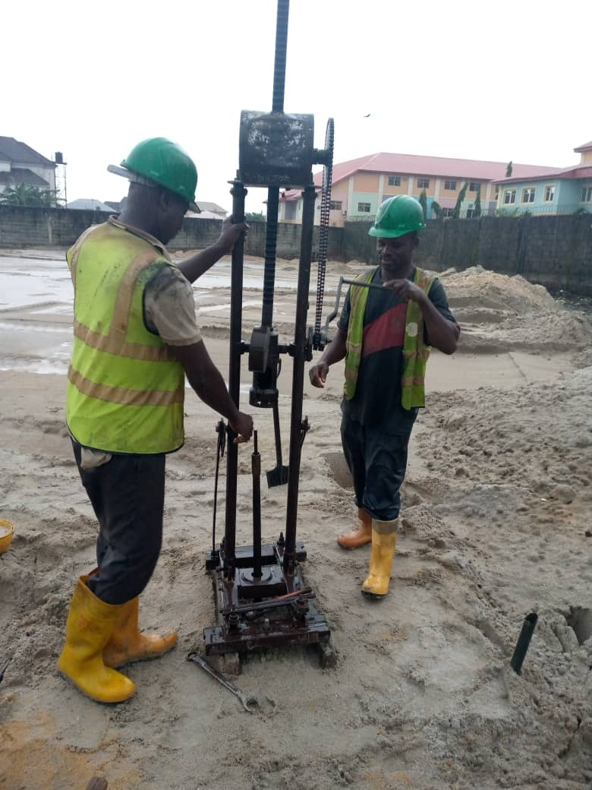
SITE
PICTURES

Slide 29
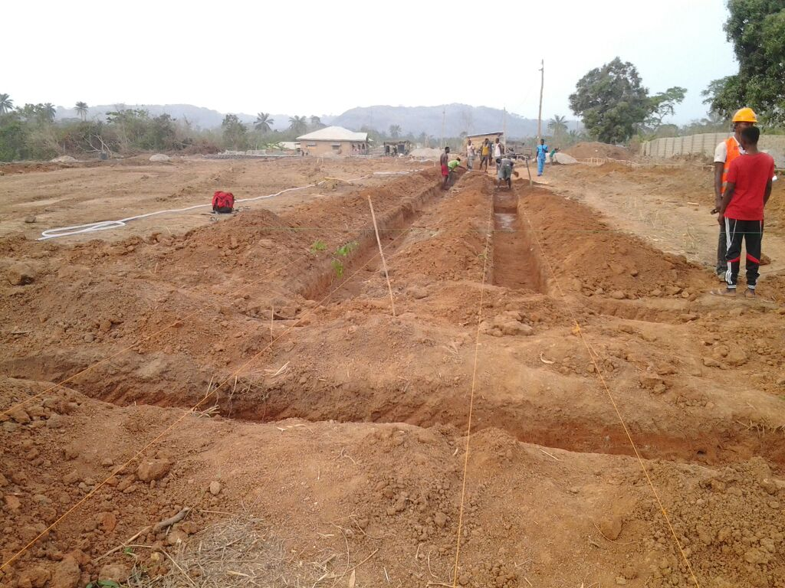
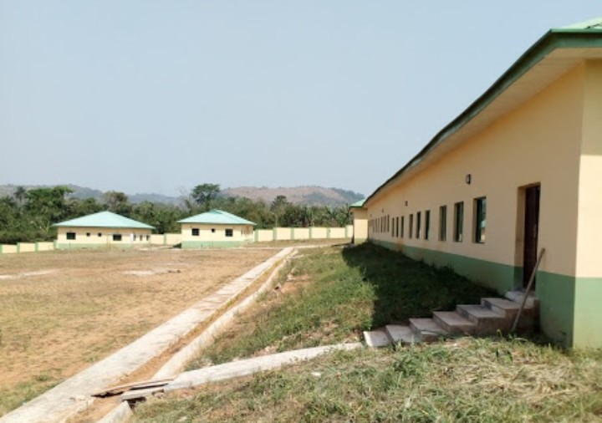
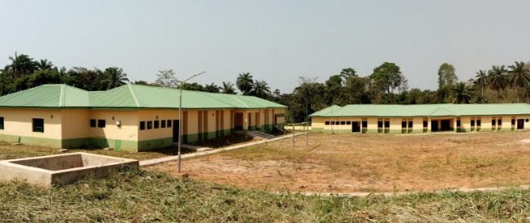
UBEC, ILAWE- JUNIOR GIRLS MODEL SECONDARY SCHOOL, EKITI STATE

Slide 30
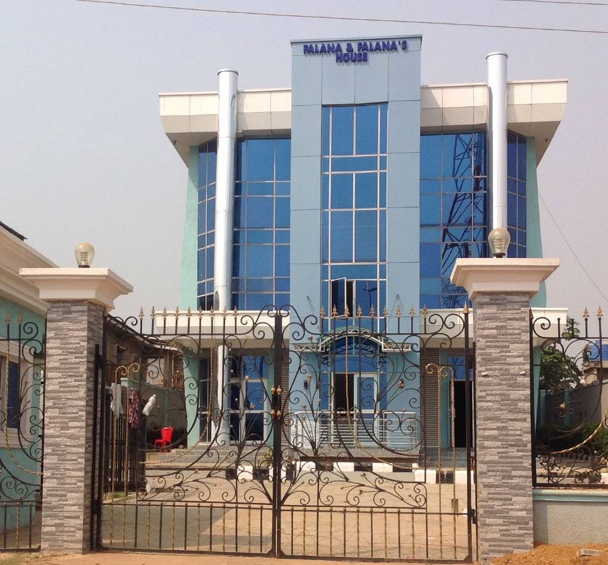
FALANA CHAMBERS, ADO-EKITI

Slide 31
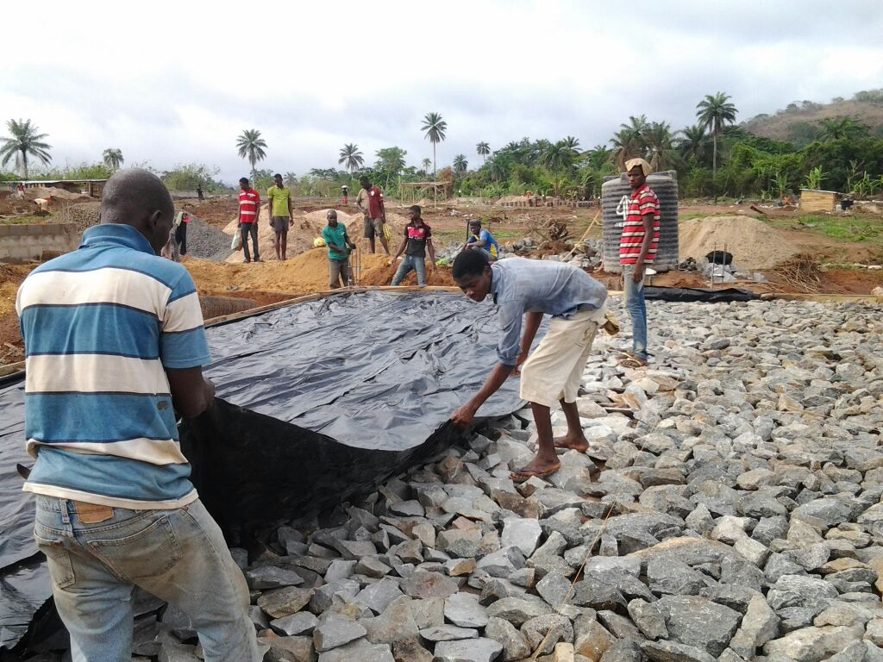
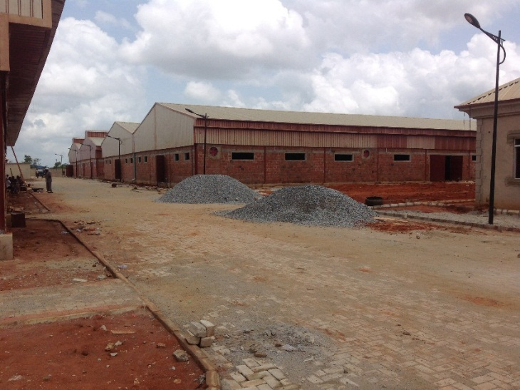
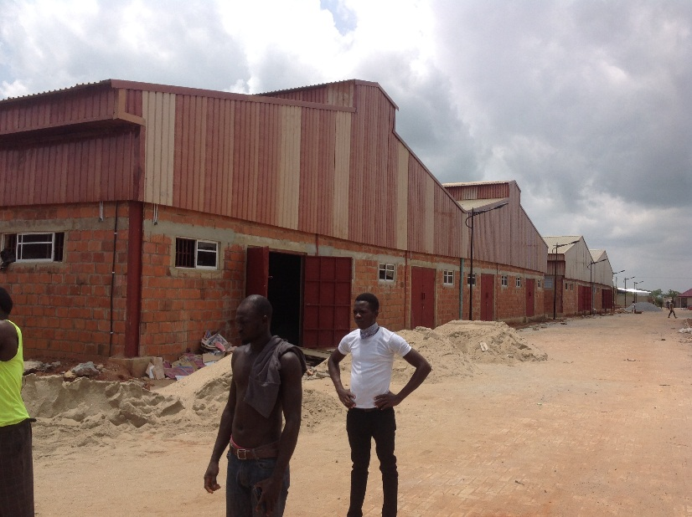
YEMKEM PHARMACEUTICAL
FACTORY

Slide 32
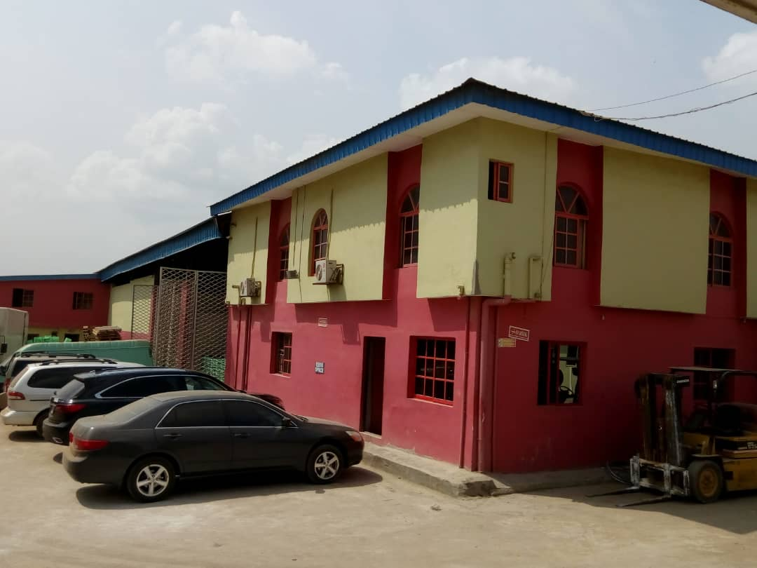
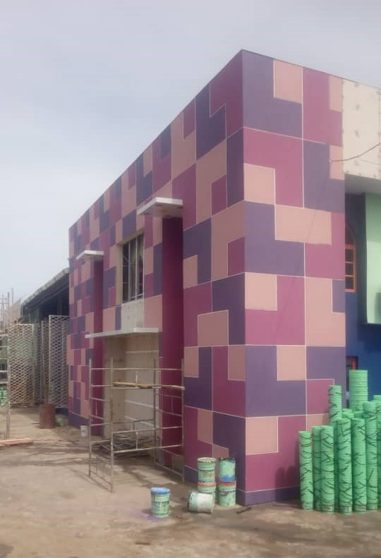
PRESTIGE PAINT FACTORY RENOVATION
BEFORE
AFTER

Slide 33
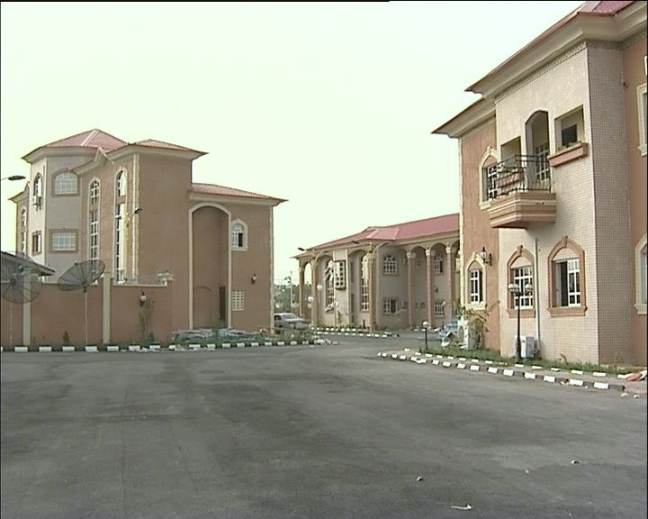
PATHFINDER HOTEL,
ADO-EKITI

Slide 34
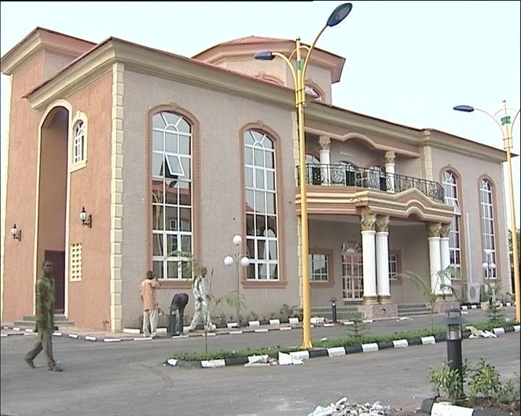
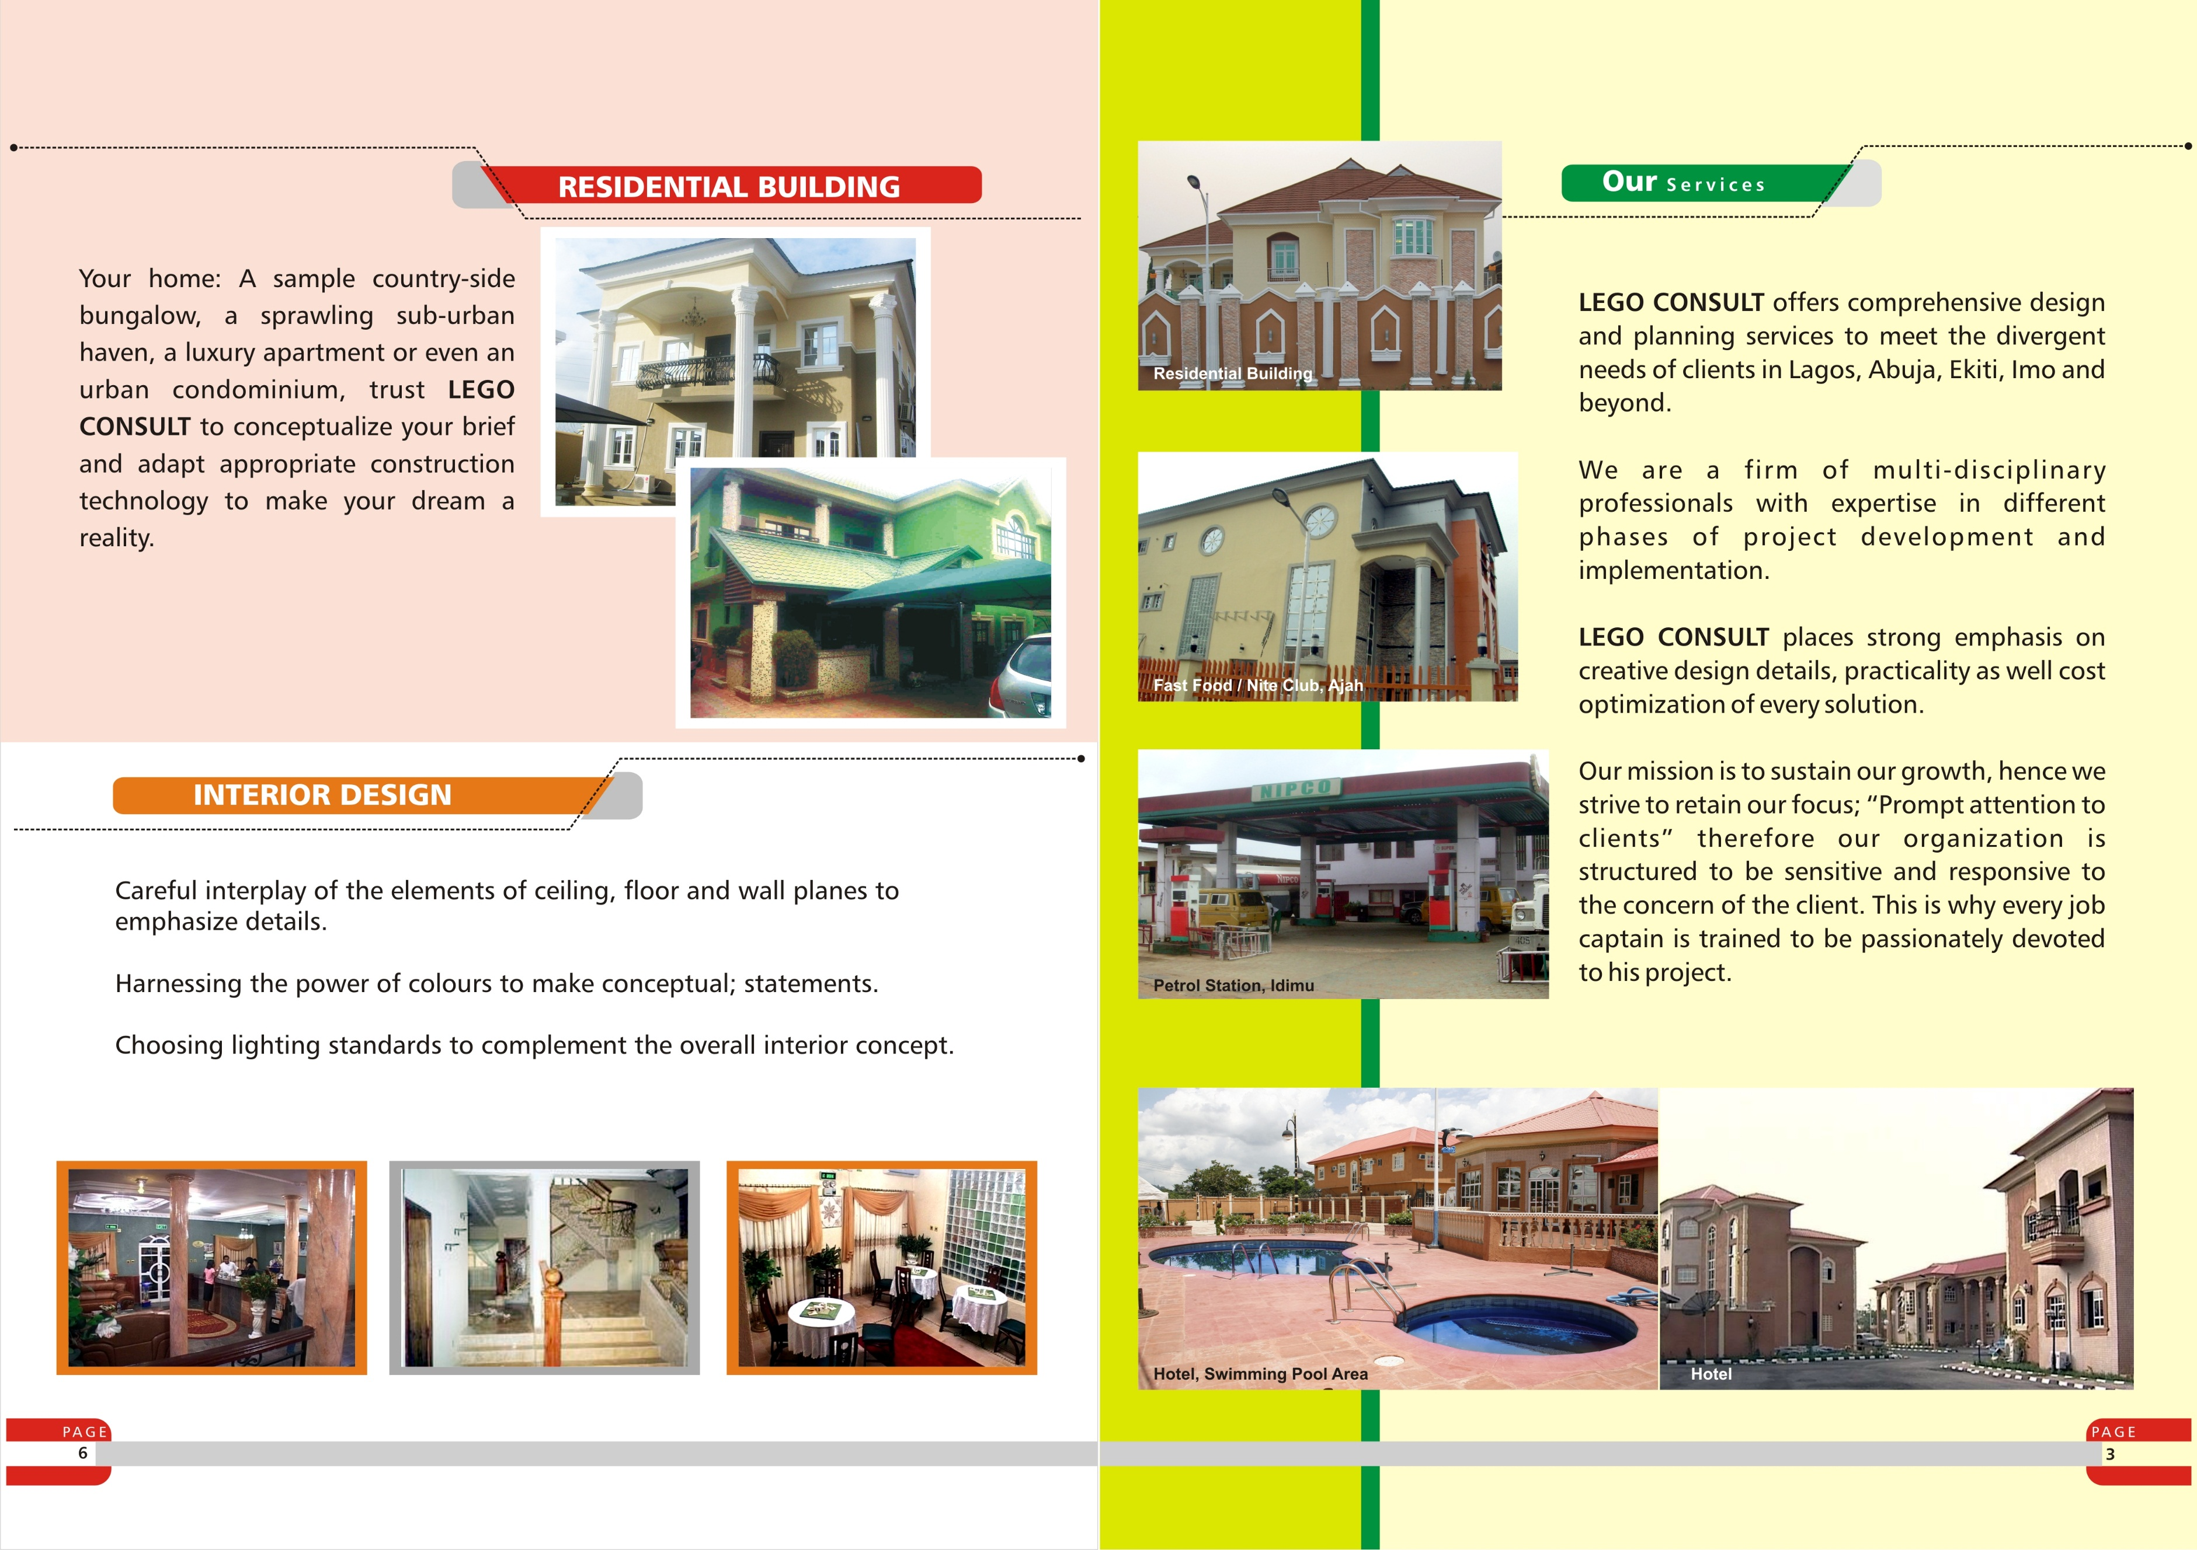
PATHFINDER HOTEL,
ADO-EKITI

Slide 35
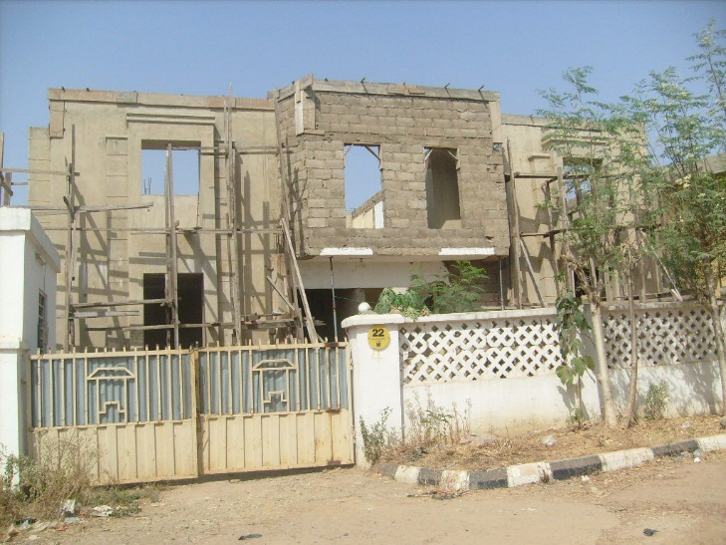
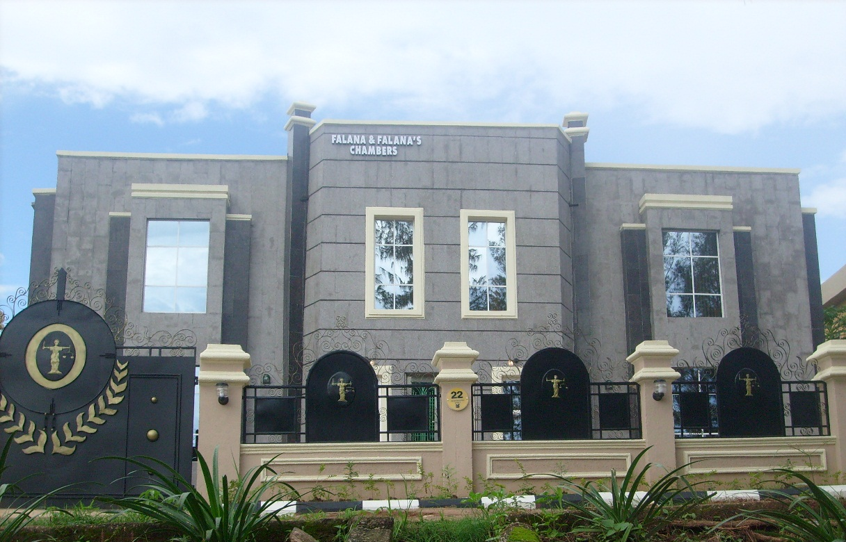
FALANA CHAMBERS,
ABUJA

Slide 36
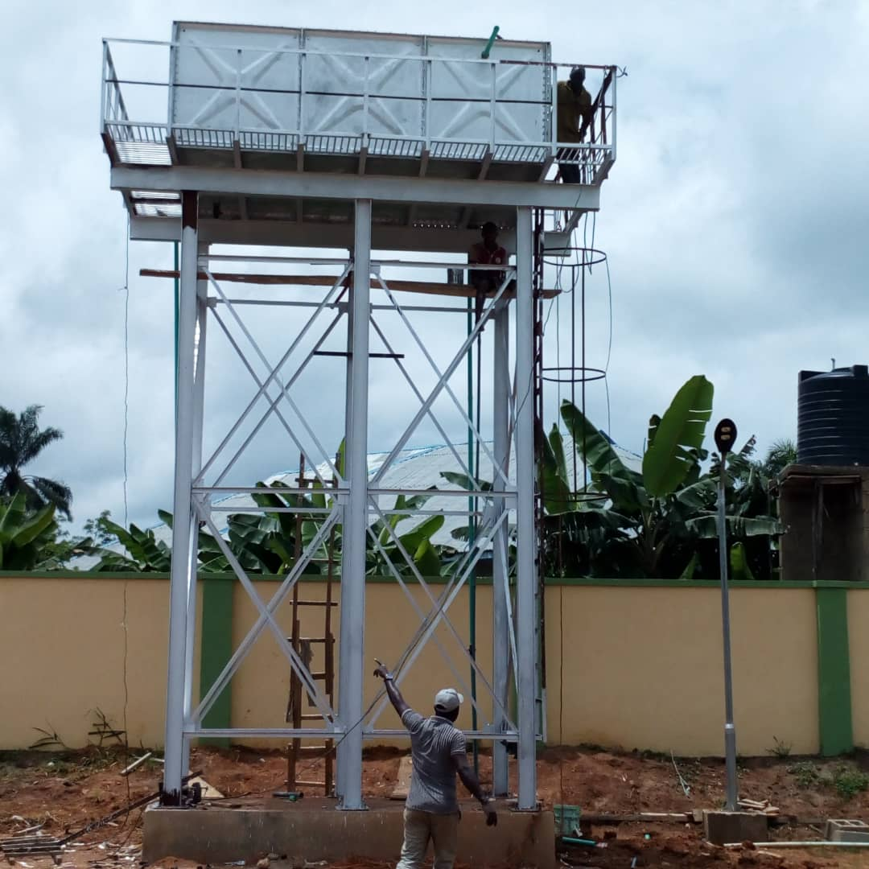
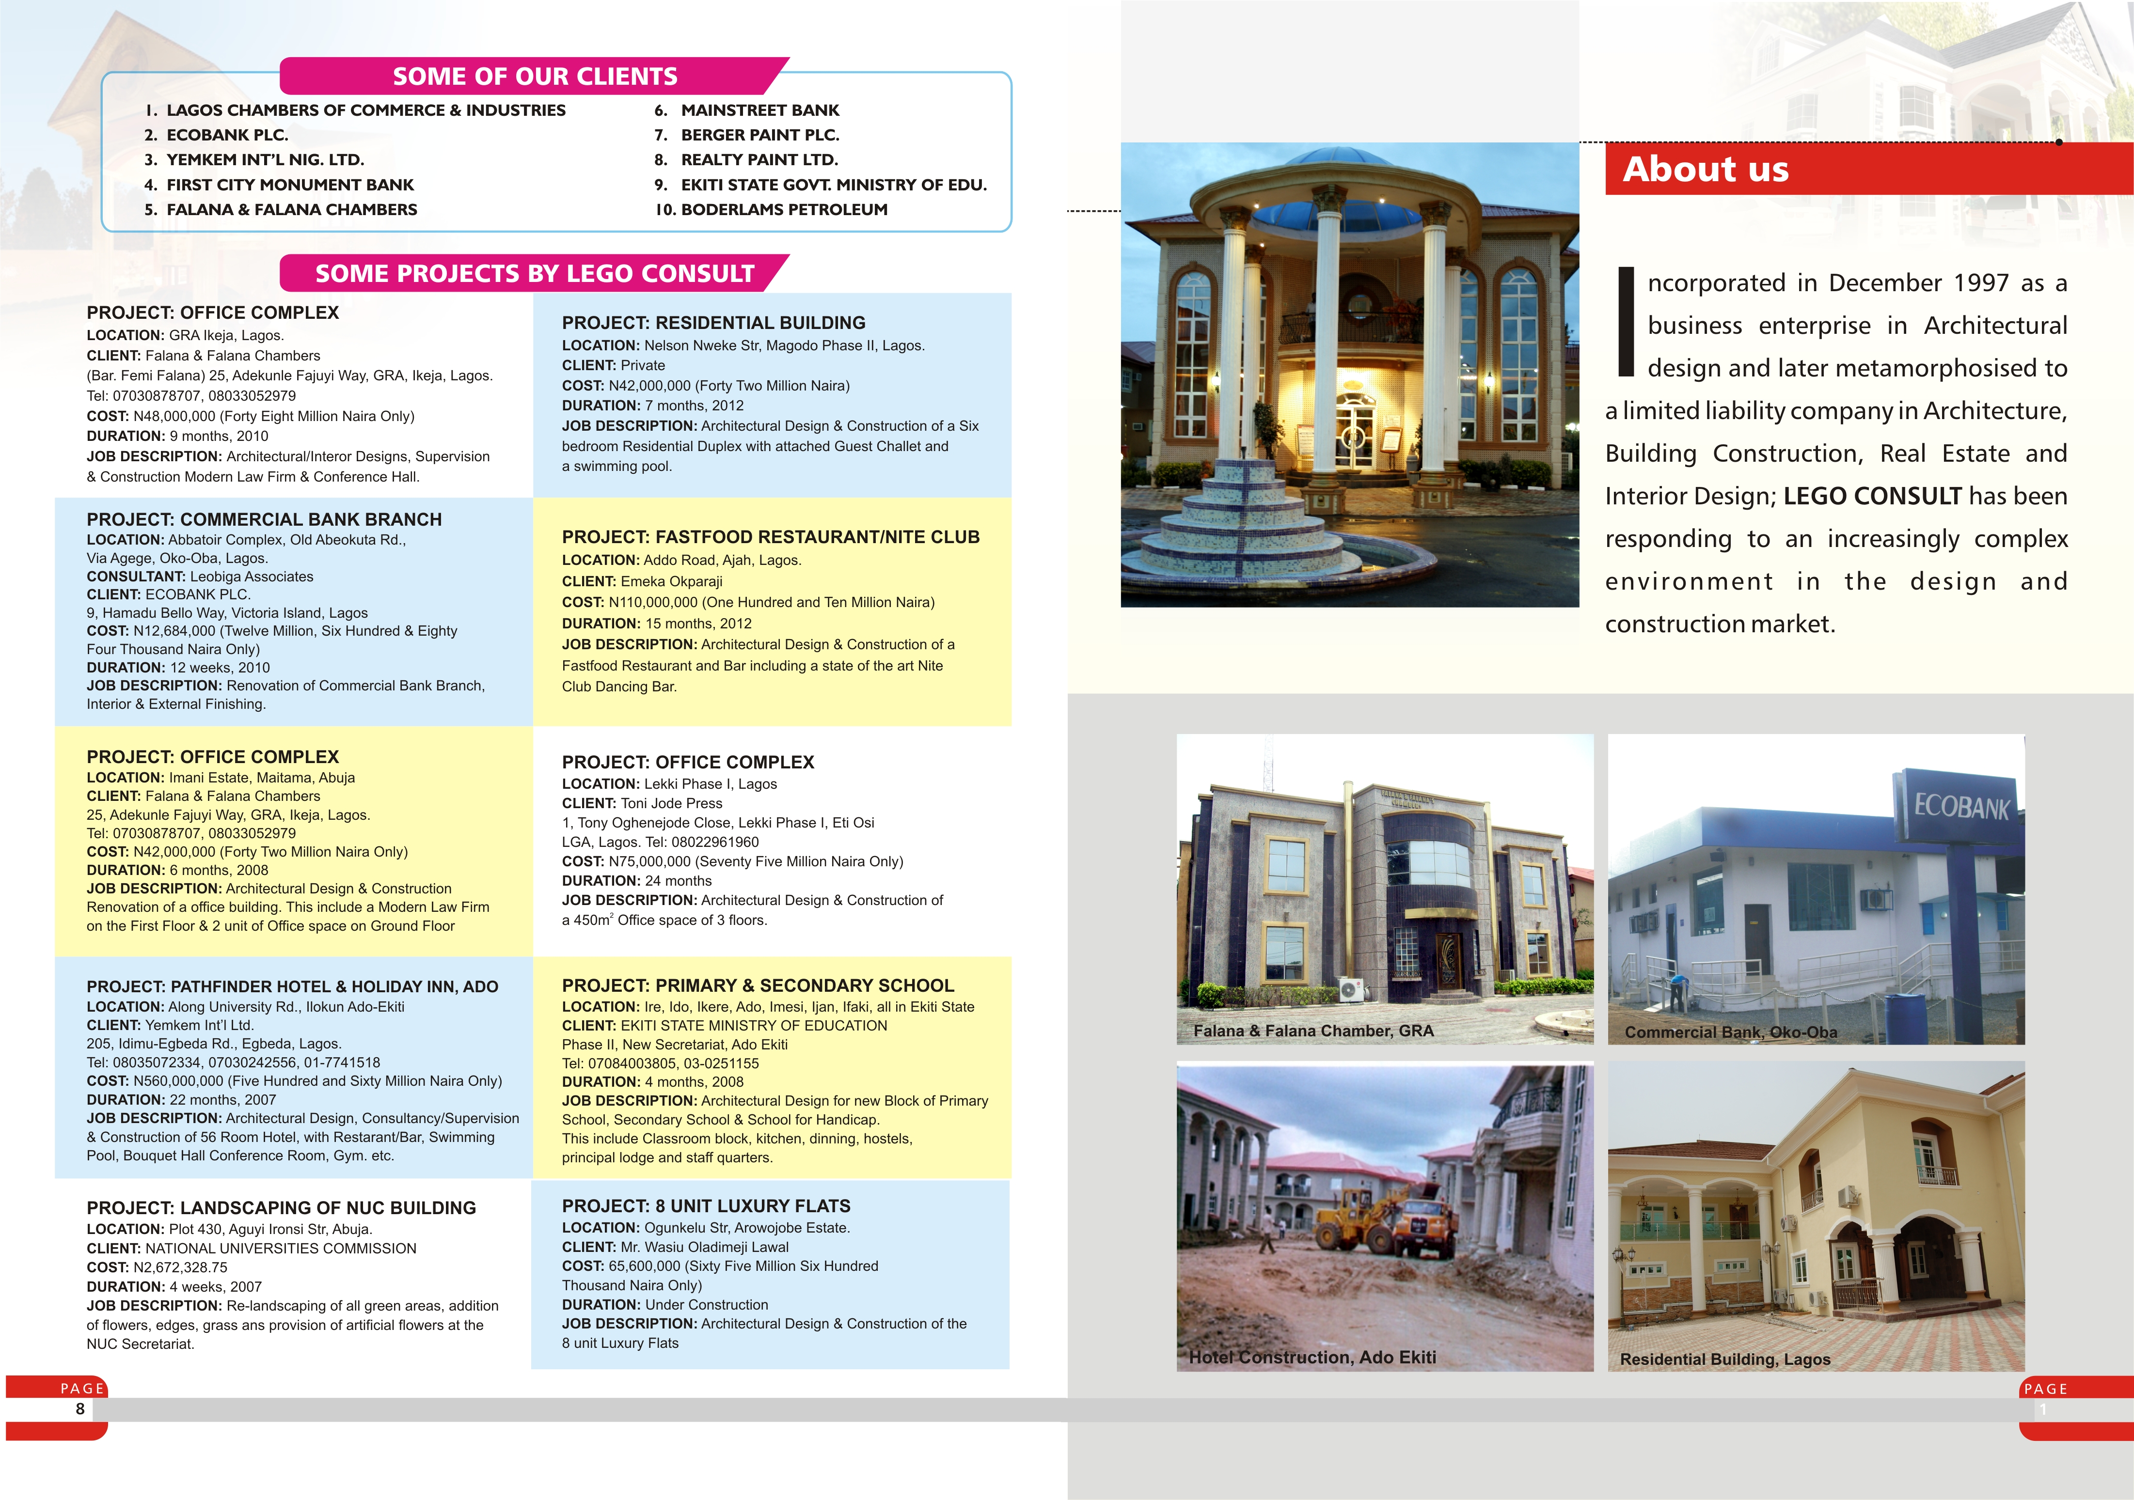
Braithwaite Tank

Slide 37
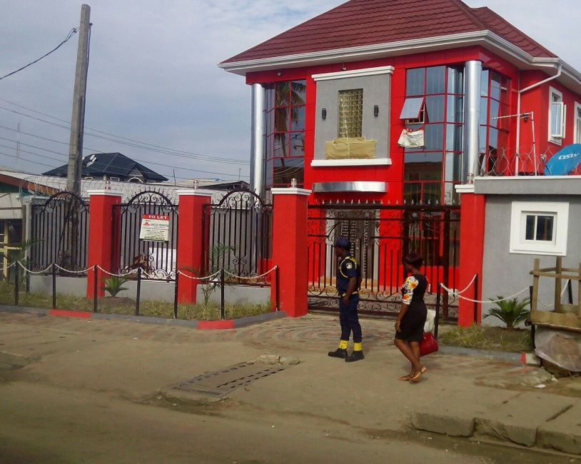

PEVE DENTAL CLINC,
AGEGE
MIXED-USE DEVELOPMENT,
IDIMU

Slide 38

GMT BONDED TERMINAL, CREEK ROAD, APAPA, LAGOS.

Slide 39


REFERENCE PROJECTS
&
PICTURES

Slide 40


Slide 41


Slide 42


Slide 43


Slide 44


Slide 45


Slide 46


Slide 47


Slide 48


Slide 49


Slide 50


Slide 51


Slide 52

LISTOF EQUIPMENTS
& MACHINERIES
JACK HAMMER EXCAVATOR
BULLDOZER

Slide 53
EQUIPMENT & MACHINERY (OWNED AND AT OUR REACHED)
S/N | TYPES | CAPACITY | MANUFACTURER | QTY. | CONDITION
A 1. 2. 3. | HEAVY DUTY BULLDOZER ROLLER STATIONERY CRANE | 0.7. D6 5 tonnes 25m Bum | Caterpillar Dynapac Portain | 1 1 1 | Working Working Working
B 1. 2. 3. 4. 5. 6. | MACHINES CONCRETE MIXER VIBRATOR COMPACTORS DUMPERS VIBRATED BLOCK MOULDING MACHINE WATER PUMPING MACHINE | - 3.0 HP - - | Benafords Lister Bomeg Winget Robinson | 3 3 1 1 1 3 | Working Working Working Working Working Working
C. 1. 2. 3. 4. 5. 6. | OTHERS SCAFFOLDS WHEEL BARROWS HEAD PANS SHOVELS DIGGERS SURVEY INSTRUMENT | - - - - - - | - - - - - Kern | 1000 50 150 150 75 2 | Working Working Working Working Working Working
D. 1. 2. 3. 4. | VEHICLES CARS PICKS UP VANS LORRIES/ TIPPERS HILUX | 2 & 3.5 litre Ridgeline/ 2.5tn 15 tons 2.7D | Toyota Honda/ Dyna Mercedes Benz Toyota | 4 2 3 1 | Working Working Working Working

